Slide 1
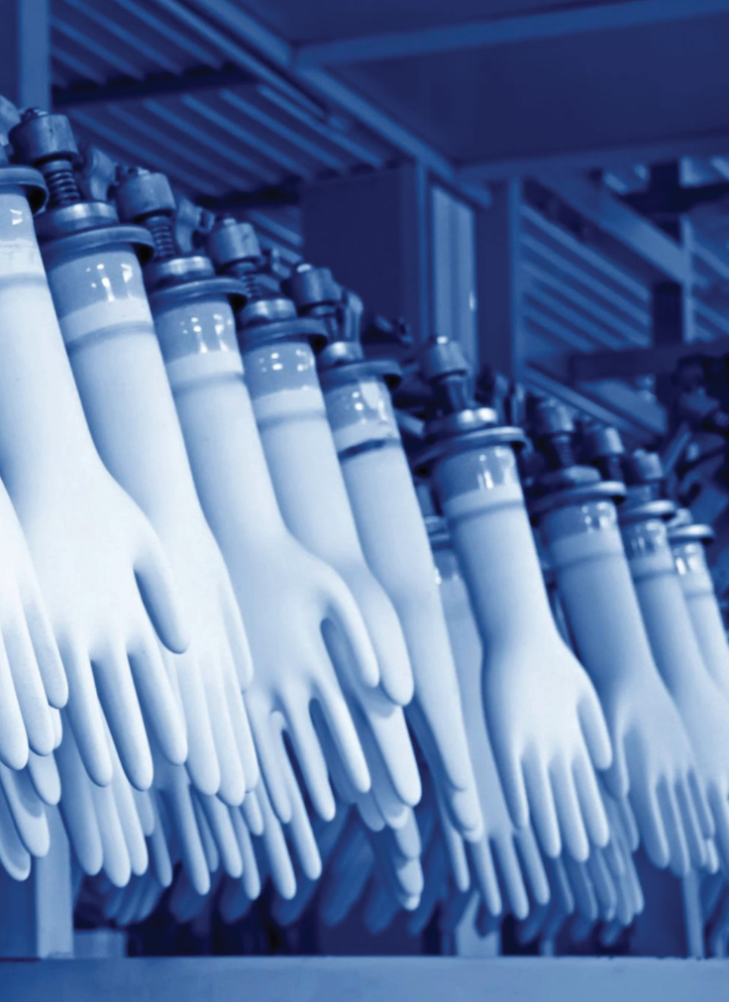
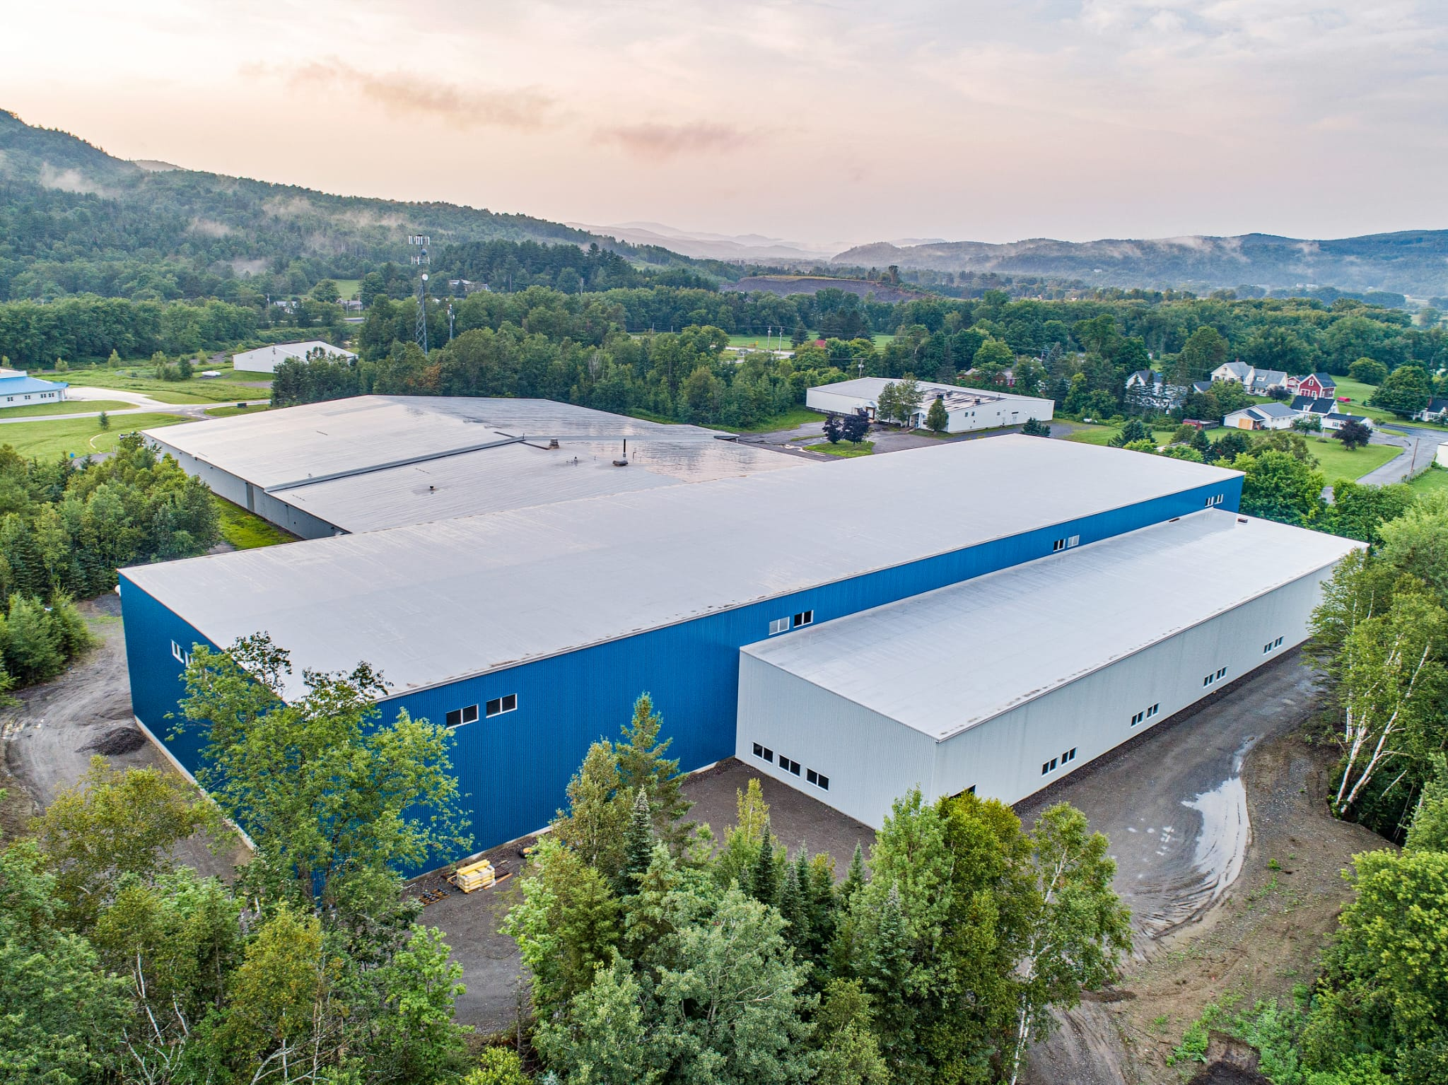
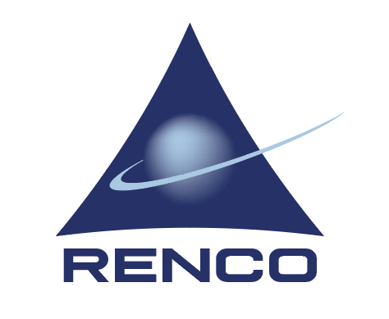
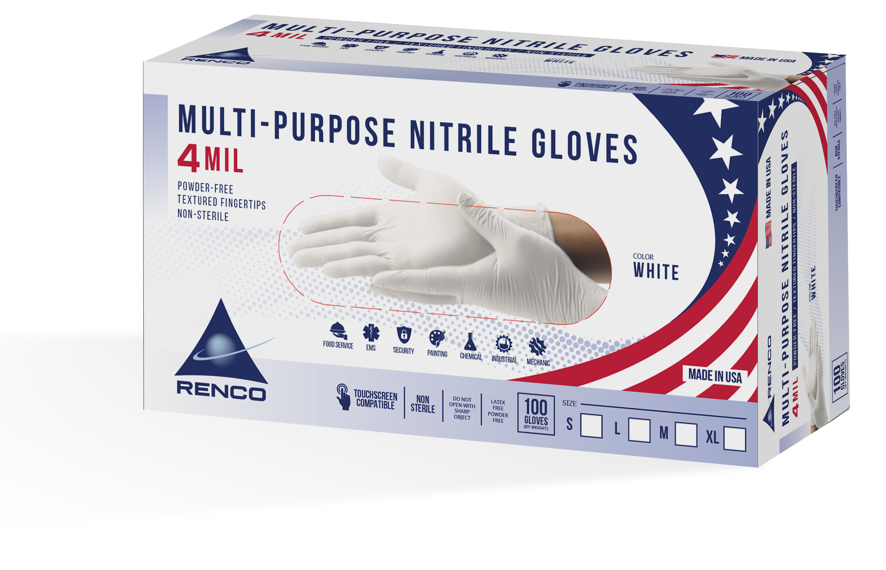
Investor Opportunity
USA Manufacturing Since 1962
2024

Slide 2
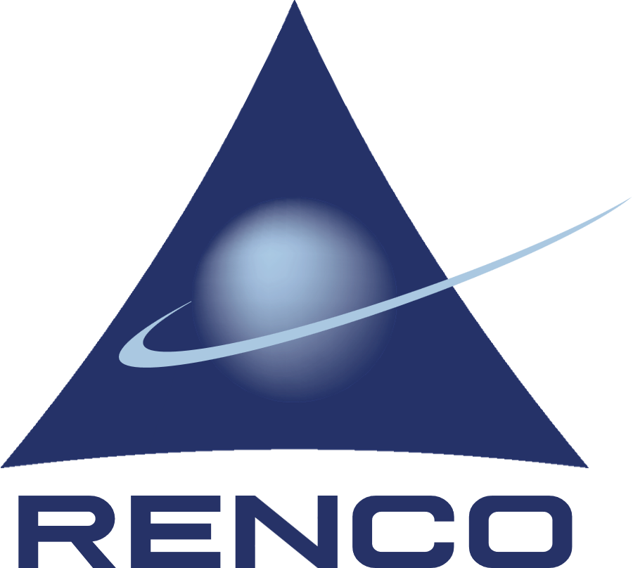
Disclaimer
Confidential Information Memorandum
The information contained in this memorandum is confidential and proprietary to Renco LLC (”Renco”, “the Company”), Renco Corporation, American Performance Polymers LLC (“APP”) and RencoMed Corporation (“RencoMed”), together referred to as the “Companies.” This memorandum is being submitted to prospective parties solely for the purpose of evaluating a potential transaction. Confidential use by such parties is with the express understanding that, without the prior written permission of Renco Corporation, American Performance Polymers LLC and RencoMed Corporation such parties will not release this document or discuss the information contained herein or make reproductions of or use this memorandum for any purpose other than evaluating a potential transaction with one or both of the companies.
Disclaimer: Forward Looking Statements
This document contains "forward-looking statements" as defined in the Private Securities Litigation Reform Act of 1995. Specifically, statements regarding American Performance Polymers or Renco’s future business, business plans, revenue projections, costs, earnings, investments, or other financial items; statements relating to the objectives of management, and statements regarding new products are forward looking statements within the meaning of the safe harbor. These statements are based on management's current expectations and actual results may differ materially from those projected as a result of certain risks and uncertainties, including but not limited to: the growth of the markets addressed by our products and our customers' products, the demand for and market acceptance of our products; our ability to successfully compete in the markets in which we do business; our ability to successfully address the cost structure of our products; the ability to develop and implement new technologies and to obtain protection for the related intellectual property; and our ability to realize financial and strategic benefits of past and future transactions. These forward-looking statements are made only as of the date indicated, and Renco Corporation, American Performance Polymers LLC and RencoMed Corporation disclaims any obligation to update or revise the information contained in any forward-looking statements, whether as a result of new information, future events or otherwise.
Market Data and Forecasts
The information in this presentation contains market data and industry forecasts and projections, including data from publicly available information and industry publications. These sources generally state that the information they provide has been obtained from sources believed to be reliable, but that the accuracy and completeness of such information is not guaranteed. In addition, their presentation includes management forecasts and projections as to the company’s performance and financial condition. The forecasts and projections are based on available information and the preparers’ experience and there can be no assurance that any of the forecasts or projections will be achieved. Management of the Company believes that the surveys and market research others have performed are reliable, but the Company has not independently investigated or verified this information. Forecasts and other forward-looking information contained herein are subject to the same qualifications and uncertainties as the other forward-looking statements contained in this presentation.
Cautionary Statements
Statements made in this presentation have not been fully evaluated or reviewed in any way by the United States Securities and Exchange Commission, the United States Department of Health & Human Services, or any other similar government agency or regulatory body. The statements in this presentation are for educational, informational purposes only and not intended for consumers or vendors.
© 2022, Renco.. All rights reserved.
CONFIDENTIAL PROPERTY OF RENCO LLC. DO NOT REPRODUCE WITHOUT EXPRESS PERMISSION OF RENCO CORPORATION

Slide 3
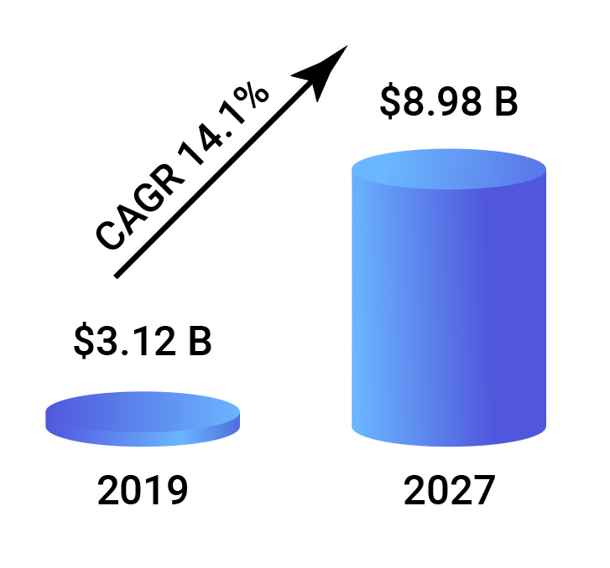
Opportunity
The global nitrile gloves market size was estimated at USD 3.12 billion in 2019 and reached USD 5.04 billion in 2025. b. The nitrile gloves market has been expected to grow at a compound annual growth rate of 14.1% from 2020 to 2027 to reach USD 8.98 billion by 2027.
North America dominated the nitrile gloves market with a share of 35.6% in 2019 owing to the increasing demand from the healthcare industry and growing awareness pertaining to workplace purity and safety. Key factors driving the glove market include rising demand for disposable gloves across the all industries along with increasing demand in the medical sectors since the outbreak of the COVID-19 pandemic.
rencogloves.com
3

Slide 4
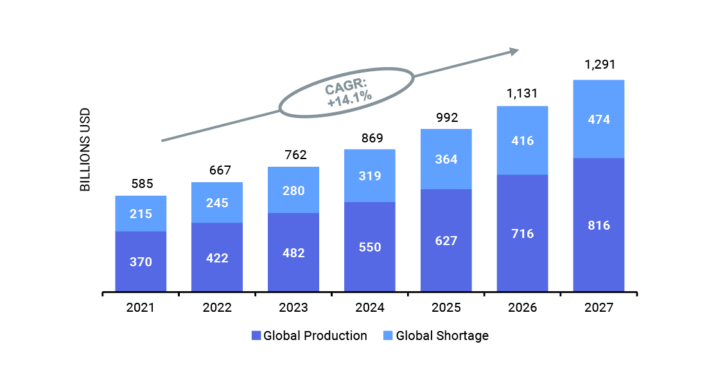
Market
U.S. Gloves Market Growth and Shortages 2021-27
Post-Pandemic: Rapidly Increasing Global Demand
Source: Market Research
rencogloves.com
4

Slide 5
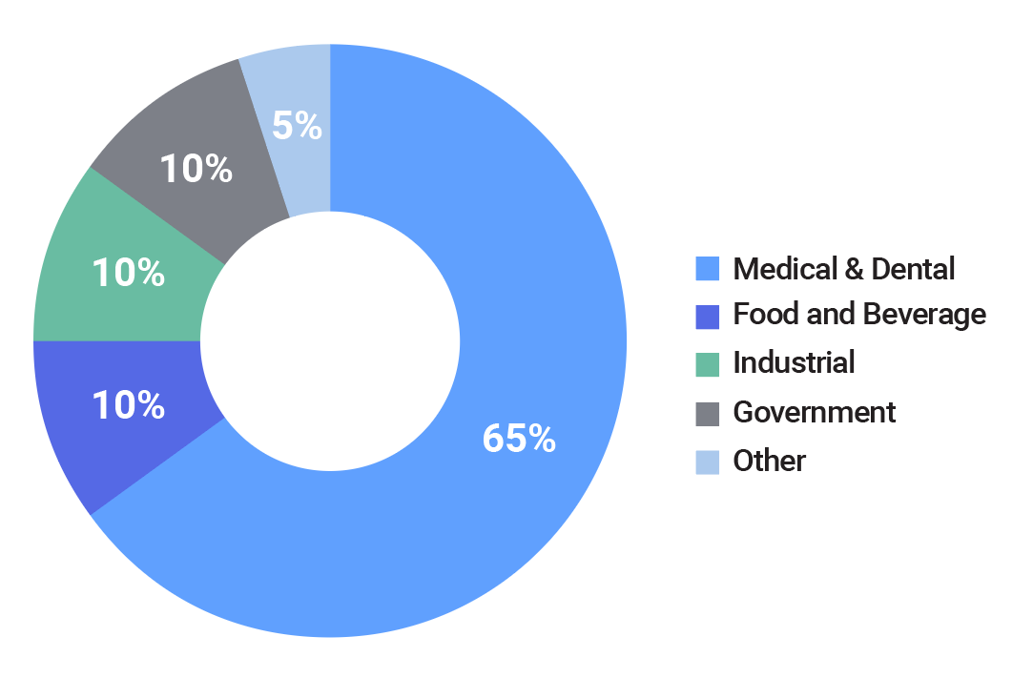
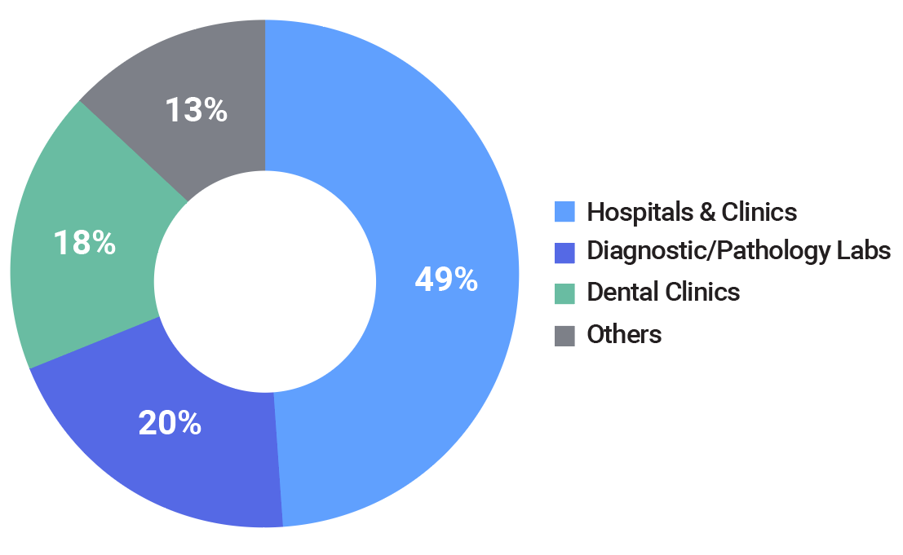
Market Details
Global Disposable Medical Gloves Market Share, Market share % by Product Category
Global Disposable Medical Gloves Market Share, By End-user, 2025
Source: Market Research
Source: Market Research
rencogloves.com
5

Slide 6
Why Renco?
Well Established & Trusted gloves company with over 62 years of experience in aseptic/cleanroom/safety gloves and systems
Deployed $70.5 M of expansion capital by the US Government
Government supports the manufacture of Nitrile gloves in USA with Make PPE in America Law and China tariffs of 100% in 2026
US Stockpile inventory has 3 to 5 years expirations, inventory is rotated every 3 to 5 years
Best knowledge with years of experience producing gloves
Owns Flexible equipment to produce specialty, medical and sterile gloves
Solid Plans with Vertical Integration and Roll-up Platforms
Location: Opportunity Zone, Foreign Trade Zone, HUB Zone
Sales and Marketing Team with key Clients
Knowledge to produce Biodegradable gloves
Knowledge for Anti-Bacterial additives for raw material
Experience with US Government: FDA, VA, HHS, DOE, DOD, etc.
Made in USA for government purchase order compliance
Low risk investment compared to imported gloves
High Margins by maintaining lower overhead
ISO 9001-2015, 510K, FDA Registered Facility
Trusted leadership team with significant industry expertise
High return profit after the 12 month of operation
rencogloves.com
6

Slide 7
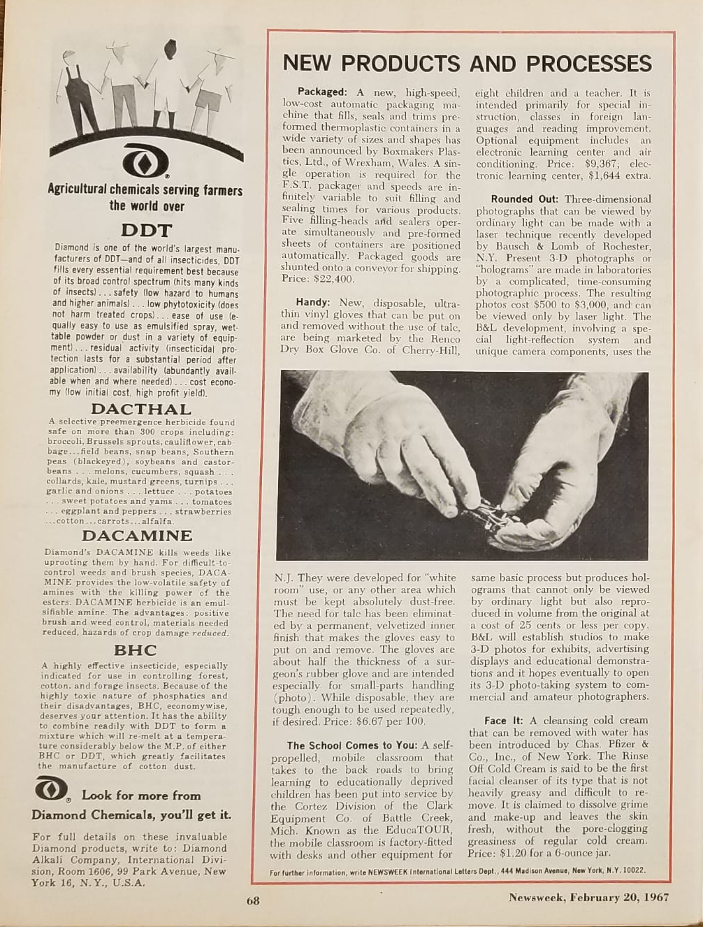
Renco has 60-years of successful operational history in manufacturing of cleanroom, sterile, protective and safety gloves
“New, disposable, ultra-thin vinyl gloves that can be put on and removed without the use of talc, are being marketed by the Renco Dr. Box Glove Co. of Cherry-Hill, N.J. They were developed for “white room” use, or any other area which must be kept absolutely dust-free. The need for talc has been eliminated by a permanent, velvetized inner finish that makes the gloves easy to put on and remove. The gloves are about half the thickness of a surgeon’s rubber gloves and are intended especially for small-parts handling (photo). While disposable, they are tough enough to be used repeatedly of desired. $6.67 per 100.”
Newsweek Magazine:
“Feb. 20, 1967”
CONFIDENTIAL PROPERTY OF RENCO LLC. DO NOT REPRODUCE WITHOUT EXPRESS PERMISSION OF RENCO LLC.

Slide 8
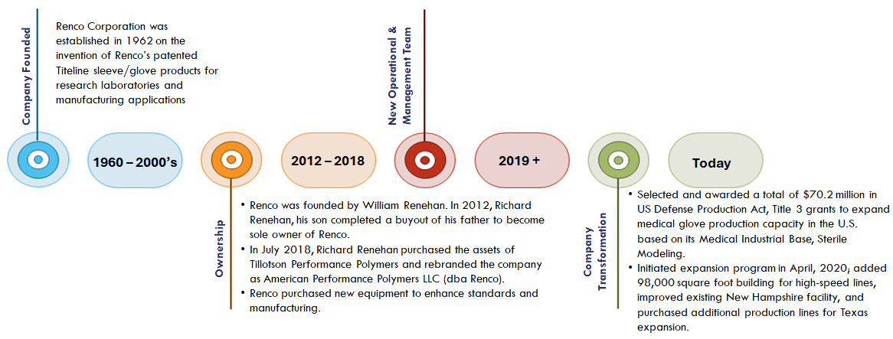
Company History
6 decades of operational excellence with expertise in exotic polymers and micro contamination control.
Received $70.5M U.S. Government grant; received completion letter.
Seeking $25M Series A to restructure and complete expansion of our New Hampshire Facility and Phase 2
https://www.rencogloves.com/
CONFIDENTIAL PROPERTY OF RENCO LLC. DO NOT REPRODUCE WITHOUT EXPRESS PERMISSION OF RENCO LLC.

Slide 9
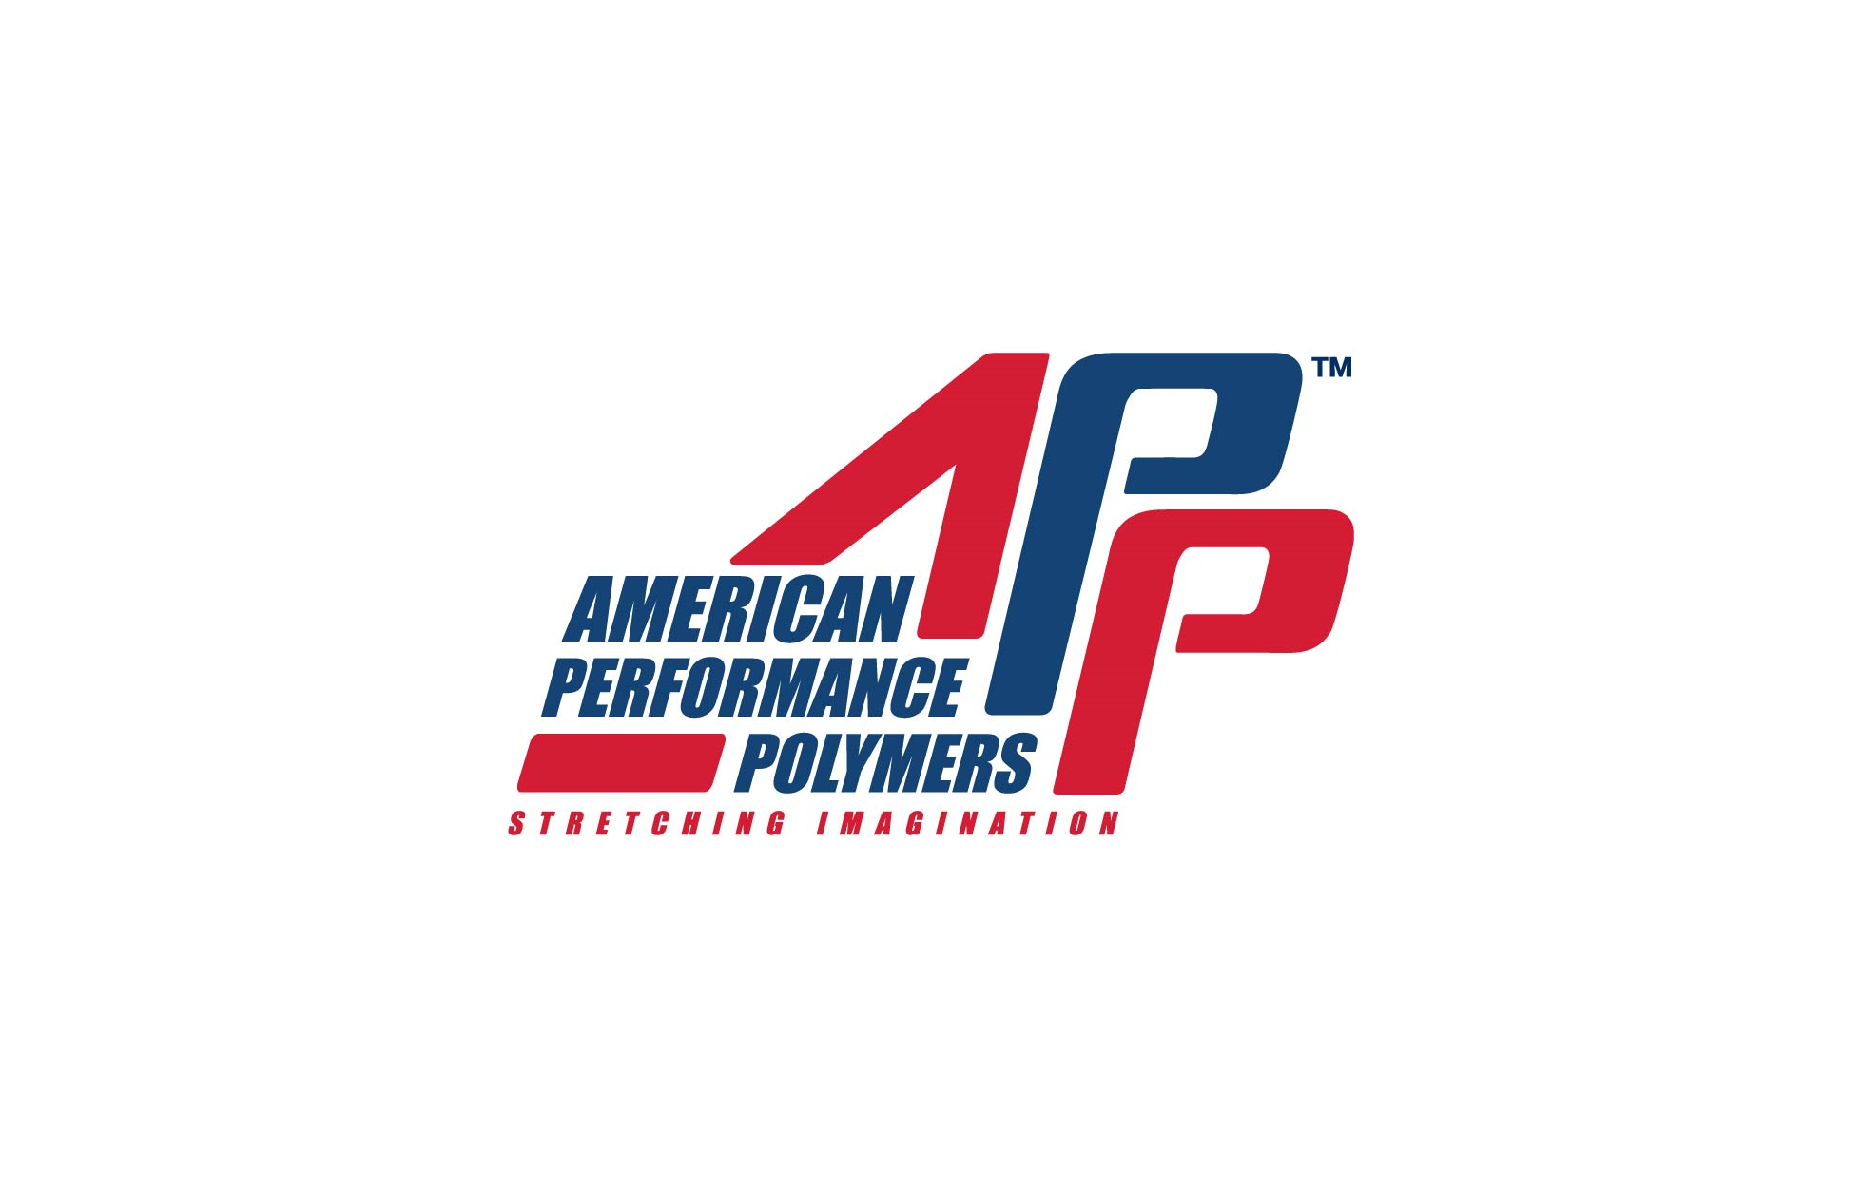
Government Partners and Funding
The US Whitehouse and DOD (Department of Defense) awarded over $70.5 million of grant money to Renco Corporation to increase glove production in the USA
Renco and APPgloves are under the leadership of Rich Renehan, CEO. The company helped reshore glove manufacturing to the USA to prevent the shortages that occurred in 2020. The US Defense Production Act (DPA) funding helped Renco increase nitrile glove production and build and maintain a warm industrial base during the Covid 19 pandemic.
Renco has nearshored and is onshoring the production of chemical and fuel handling gloves for the US Defense Logistics Agency (DLA).
Renco produces, packs and sterilizes gloves for the production and filling of essential vaccines and for patient and product testing.
rencogloves.com
9

Slide 10
Renco/APP Customers
Main Customer by Product Category
Medical Product Distributors
and End User
Food and Beverages products distributors and end users
Medical Buying Group
Medline
McKesson
Cardinal Health’
Owens and Minor
Premier
HCA
Amerisource Bergen
Vizient
United Healthcare
Sysco
Yum Food
HEB
McDonalds
Tyson
Aramark
Cintas
Kraft/Heinz
Industrial Product distributors and end users
Government agency
Pharmacy
Walmart
CVS
Walgreens
FEMA
Department of Defense
TSA airline
Department of Labor
Department of Health & Human Services
Grainger
Fastenal
Uline
Global
Cintas
GM
FORD
TOYOTA
Fisher Scientist
Ecolab
Rite Aid
Weggans
Kroger pharmacy
rencogloves.com
10

Slide 11
Domestic and International Competitors
Lists of Entities Expanded During Covid 19
USA Manufacturing Competitors:
Oversea Manufacturing Competitors:
Isikel.com
usmedicalglove.com
aureliagloves.com
americannitrile.com
ventyv.com
usagloves.com
showagroup.com
intcomedical.com
medicalkingfa.com
topglove.com
hartalega.com.my
ansell.com
supermax.com.my
kossan.com.my
vietglove.vn
rencogloves.com
11

Slide 12
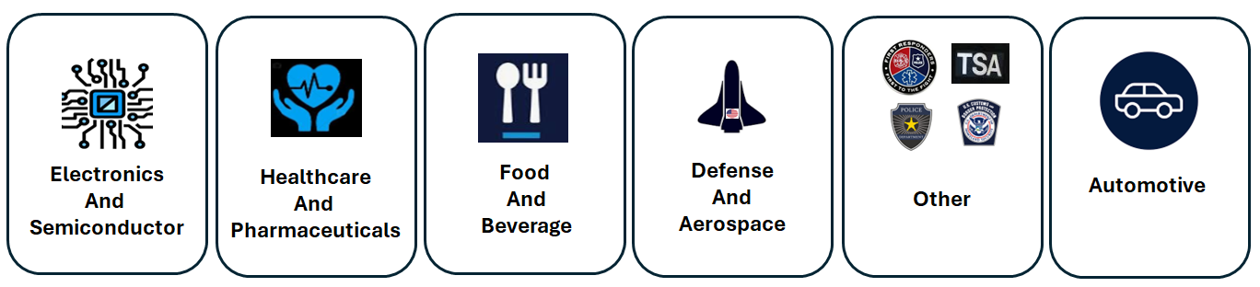
Renco Markets Served by Industry
Global medical gloves market to reach $46.9 billion by 2030 1.
1. https://finance.yahoo.com/news/global-medical-gloves-strategic-business-122800089.html?guccounter=1&guce_referrer=aHR0cHM6Ly93d3cuZ29vZ2xlLmNvbS8&guce_referrer_sig=AQAAALLFO29VbN1OrHZLNl1dOFcAm0DKJFvu-Z9Htnp7Lm4jw9prFJmjyCFLqiV6EU1gBtlk3s_Ph5vrD2HsXiw5Ri1g_ZJN YDR_uHyrXD9TfAlgIKiYyIgtnj_1gJx2c7MC6gCGH_EovXl9W3CxXgA_TrjUqZSU7_A5gsScgd0jfE2
\
CONFIDENTIAL PROPERTY OF RENCO LLC. DO NOT REPRODUCE WITHOUT EXPRESS PERMISSION OF RENCO LLC.

Slide 13

Supply Challenges
The COVID-19 pandemic exposed a critical weakness in the U.S. medical supply chain- the extreme overreliance on foreign countries for U.S. medical supplies.
Fewer than 1% of Nitrile Gloves are manufactured in the U.S.
In 2019, the year preceding the COVID-19 pandemic, 11% of medical exam gloves used in the U.S. were imported from China.
By Q2 2023, 41% of the gloves used in the U.S. were imported from China. The weaponization by China of a critical aspect of PPE has businesses and government concerned as they seek solutions to a probable disruption to our supply chain.
Beyond supply chain issues, the quality of Nitrile Gloves manufactured oversees has dropped significantly– frontline workers and first responders are receiving gloves made with poor quality NBR and some, with stains and tears, putting their health and safety at risk.
CONFIDENTIAL PROPERTY OF RENCO LLC. DO NOT REPRODUCE WITHOUT EXPRESS PERMISSION OF RENCO LLC.

Slide 14
Market Size and Data
USA Nitrile latex and Glove demands and Utilization Analysis
SA has been consumed about 100 billion pieces nitrile examination glove before COVID-19 which is about 30-35% of global nitrile examination glove consumption. During pandemic 2020-2021 period that the demand is double and estimated the demand growing is about 8% a year aft
Estimated at least 50% of glove consumption is supplied by the domestic manufacturers by the policy supporting and good willing of “Buying American Products”.
Description | 2020-2021 | 2022 | 2023 | 2024 | 2025 | 2026
USA Glove Demand (Billions/year) | 200B | 126B | 136B | 147B | 159B | 172B
50% Domestic supplying | <1B | 63B | 68B | 73.5B | 79.5B | 86B
Domestic Glove Capacity (Billion pieces/year) |  | 20B | 57B | 90B | 120B | 131B
Glove Capacity Utilization |  | 315% | 119.3% | 81.7% | 66.3% | 65.6%
Import Glove Q’ty (Billions/year) | 199B | 106B | 79B | 73.5B | 79.5B | 86B
USA NBR Latex Demand |  | 150,000 | 427,500 | 551,250 | 596,250 | 645,000
NBR Latex Capacity (tons/year) |  | 270,000 | 400,000 | 580,000 | 580,000 | 580,000
NBR Capacity Utilization |  | 55.6% | 107% | 95% | 102.8% | 111.2%
rencogloves.com
14

Slide 15
Exam Glove Market Growth
Global NBR and Examination Glove Expansion and Forecasting
The global nitrile examination glove demands are growing 7.7% a year before COVID-19, after the mid of 2022 glove demands will back to normal trend so as glove’s ASP (Average Sale Price).
China nitrile examination glove importing tariff to USA is increasing to 50% January 1, 2025, and 100% in 2026 for medical grade gloves made in China.
Description | Before COVID-19 | 2020 | 2021 | 2022 | 2023 | 2024 | 2025
Global Glove Demand (Billions/year) | 320B | 650B | 650B | 450B | 400B | 420B | 450B
Glove Capacity (Billion pieces/year) | 350B | 420B | 610B | 882B | 1003.6B | 1100B | 1263B
Glove Capacity Utilization | 91.4% | 100% | 78% | 51% | 39.9% | 38.2% | 35.5%
Glove ASP ($/1000 pieces) | 22-24 | 24-120 | 120-24 | 24-18 | 18-22 | 20-22 | 21-23
Global NBR demand (Million tons/year) | 2.5 M | 3.4 M | 3.7 M | 3.6M | 3.1 M | 3.3M | 3.6M
NBR Latex Capacity (Million tons/year) | 2.8 M | 2.8 M | 3.0 M | 4.5 M | 5.3 M | 5.5M | 5.5M
NBR Capacity Utilization | 90% | 120% | 123% | 80% | 58% | 60% | 65.5%
NBR Latex ASP (US$/ton) | 1000-1200 | 1500-2500 | 2500-1250 | 1250-900 | 900-1100 | 1100-1200 | 1100-1200
rencogloves.com
15

Slide 16
Renco Objectives
Renco 2025
  Develop/Supply Cutting Edge Products for its global client base
  Maintain 62 Years of Brand Loyalty to Current Product Lines
  Expand the High Margin Glove Markets
  Expand the Sales Force to Market to Renco’s Blue Chip Customer Base
  Enhance Relationships with Master Distributors and Catalog Houses for Renco and Private Branded Products
  Provide Berry Compliant Products For Renco’s US Government Clients with USA Manufacturing Facilities for Med/Safety Gloves
  Roll-up US Distributors and Manufacturers to Expand Market Presence
rencogloves.com
16

Slide 17
American Performance Polymers / APPgloves NH
2025
Colebrook NH: > 200,000 sq ft manufacturing, R&D and distribution space on 14 acres
4 High Speed exam gloves machines: >225 million gloves/Line >>>>>>>>>>>>>>>>>>>>>>>> 900 Million Gloves/Year
10 Flexible Dip Lines for Custom Medical and Sterile gloves: > 25 million gloves/Line >>>>>> 250 Million Gloves/Year
Q1 2025
Month 2
Month 3
Month 4
Month 5-36
Finish Big Blue Factory (100,000’) for Production
Produce with 2 flexible dip lines
Finish USG Otto Fuel Orders
Expand Hand-Dip Long Margin Gloves
Continue Finish work on Big Blue
Continue production on 2 additional flexible dip lines
Initiate Clean-process Pack and Ship
Continue Hand-Dip Long Margin Gloves and Sleeves
Continue Finish work on Big Blue
Continue production on 2 additional flexible dip lines
Continue Clean-Process Pack and Ship
Continue Hand-Dip Long Margin Gloves and Sleeves
Continue Finish work on Big Blue
Continue production on 2 additional flexible dip lines
Continue Clean-Process Pack and Ship
Continue Hand-Dip Long Margin Gloves and Sleeves
Continue Operations, Employment, Training and Expansion
Rinse and Repeat
rencogloves.com
17

Slide 18
Timetable-Pandemic Response Plan
Renco serves with FEMA Ibx and with WH Digital Stockpile Commissions. In the event of Pandemic X or other Supply Chain Disruptions, the company has plans for:
10 High speed exam nitrile gloves machine 225,000 millions gloves each to be rapidly deployed
Vertical Integration and Cooperative Partnering
From Date of New Funding:
Month 1
Month 2
Month 3
Month 4
Month 5
Month 6
Raise Capital via Equity
Building renovation and Energy Plans
Run Flex Lines to Fill Domestic and International Orders
Sales Plan Implementation
Raise Operating Capital
Build a marketing plan to promote Brand and Domestic Manufacturing Capacity
Planning processes for NBR and other chemicals
Install Sprinkler system
Promote online and direct agent salesl
Fulfill Purchase Orders for USA sourced products
Building Completion
Fund and Complete HSL 1 and 2
Continue Flexible Diplines 10-16
Continue installing machines 1& 2
Construction of Chemical Compounding and Testing
Continue HSL 1&2 Installation
Continue Pre-Sold Flexible Diplines 11-20
Continue Sales Support and Product Line Management and Expansion
rencogloves.com
18

Slide 19
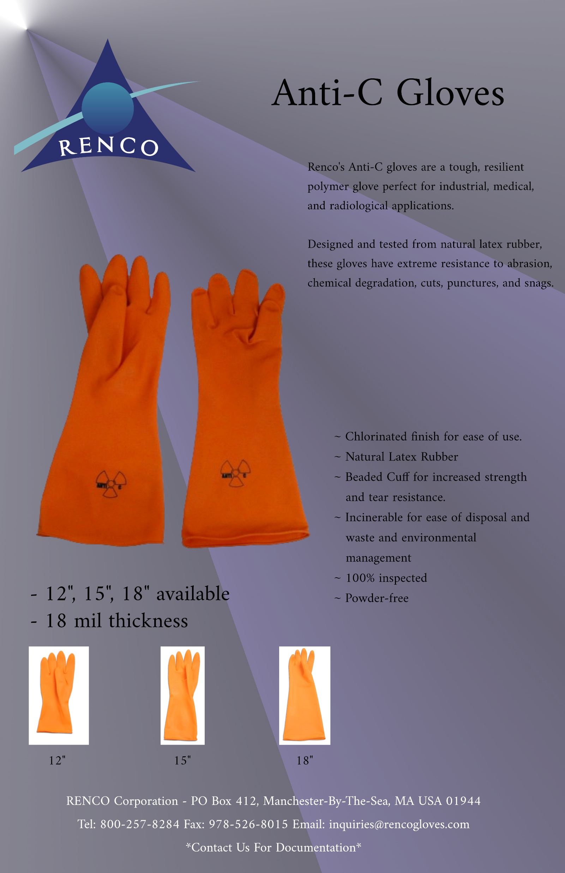
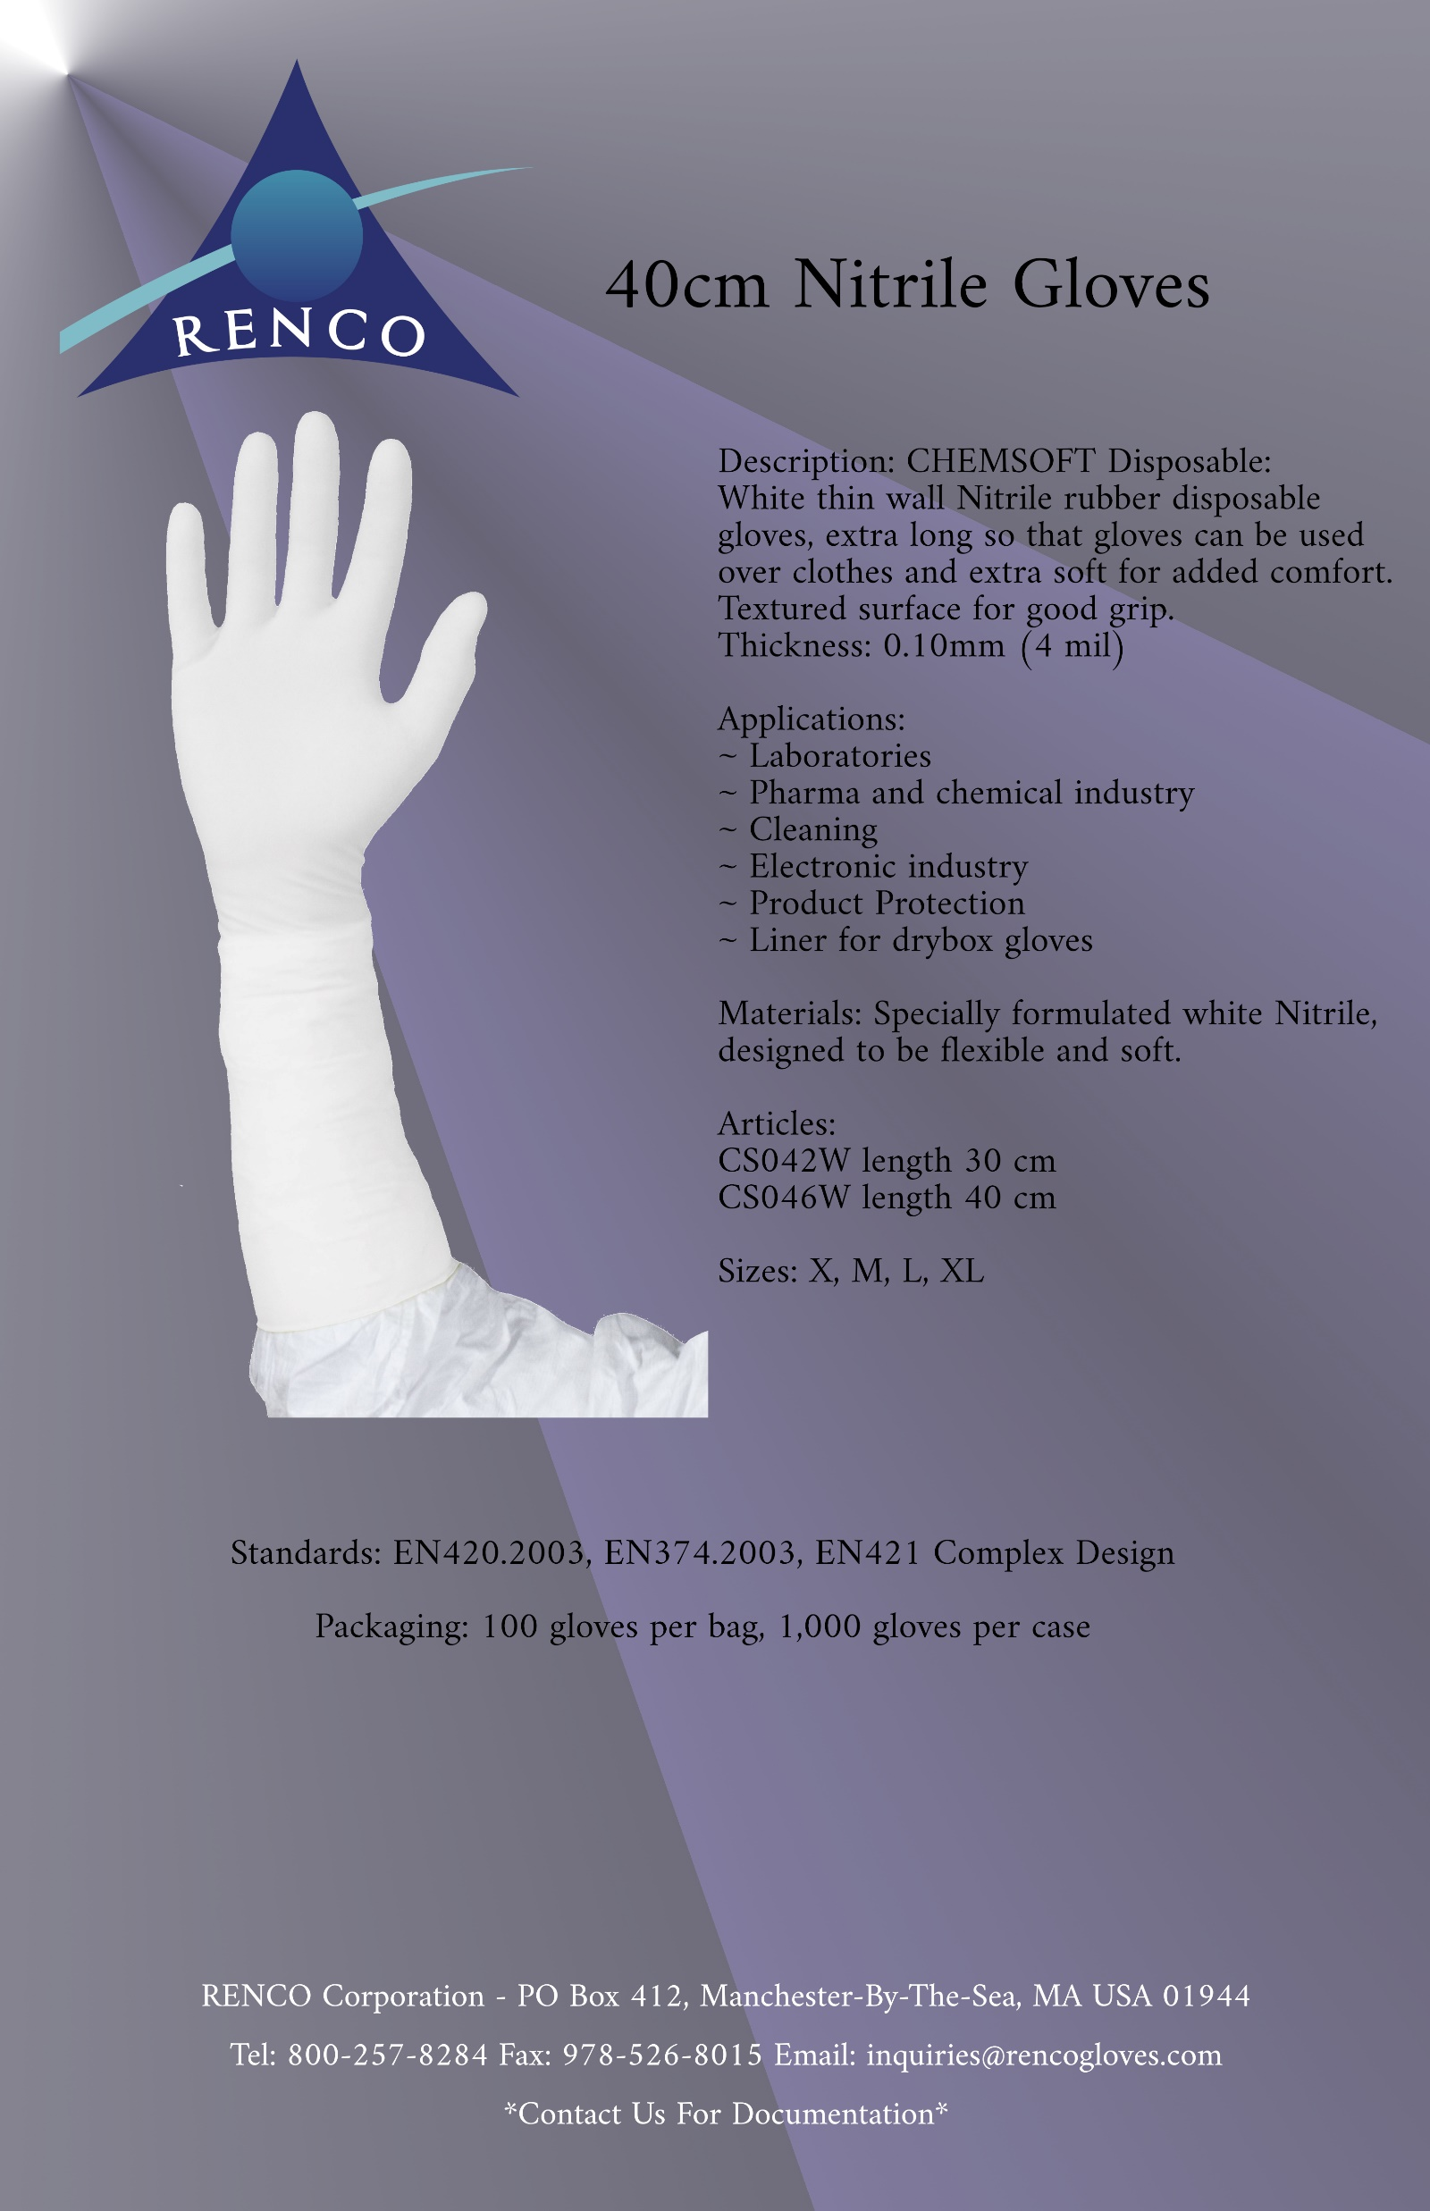
Specialty Products
4 mil gloves provide an excellent fit and feel, superior comfort and tactile sensitivity, and a great barrier in a nitrile exam style glove
6 mil gloves are ideal for moderate-to-high risk settings and are great for lab use and ISO 7 clean facilities
8 mil gloves offer the highest protection and are optimal for industrial use, heavy equipment, emergency response etc.
Renco’s production process boosts the tensile strength of nitrile to increase its protection qualities
Gloves Type | 4 mil | 6 mil | 8 mil
FDA 510K Approved | Yes | Yes | No
NFPA Standards | 1999:2008 | 1999:2008 | 1999:2008
Quality Standards | ASTM 6319 | ASTM 6319 | ASTM 6319
Average Length | 9.5” (235mm) | 9.5” (235mm) | 9.5” (235mm)
Before Aging (Strength) | 42 MPa | 21 Mpa | 21 Mpa
Before Aging (Elongation) | 650% | 550% | 450%
After Aging (Strength) | 38 Mpa | 21 Mpa | 21 Mpa
After Aging (Elongation) | 550% | 500% 400%
rencogloves.com
19

